Slide 1
Chapter 5 Arrays
Introducing Arrays
Declaring Array Variables, Creating Arrays, and Initializing Arrays
Passing Arrays to Methods
Copying Arrays
Multidimensional Arrays
Search and Sorting Methods
17 october 2016
Akash Kumar Choudhary

Slide 2
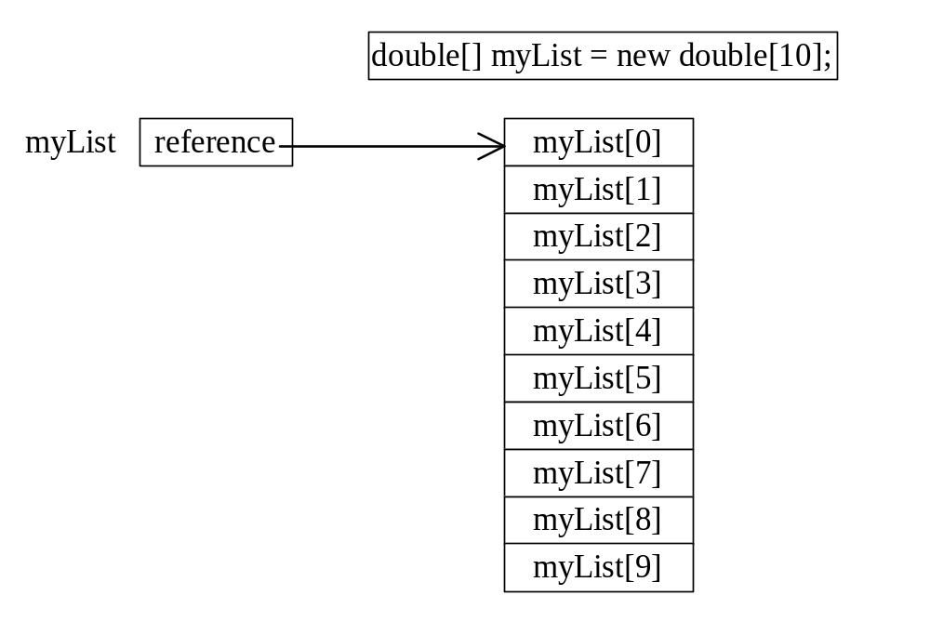
Introducing Arrays
Array is a data structure that represents a collection of the same types of data.
An Array of 10 Elements
of type double
17 october 2016
Akash Kumar Choudhary

Slide 3
Declaring Array Variables
datatype[] arrayname;
Example:
double[] myList;
datatype arrayname[];
Example:
double myList[];
17 october 2016
Akash Kumar Choudhary

Slide 4
Creating Arrays
arrayName = new datatype[arraySize];
Example:
myList = new double[10];
myList[0] references the first element in the array.
myList[9] references the last element in the array.
17 october 2016
Akash Kumar Choudhary

Slide 5
Declaring and Creating in One Step
datatype[] arrayname = new
datatype[arraySize];
double[] myList = new double[10];
datatype arrayname[] = new
datatype[arraySize];
double myList[] = new double[10];
17 october 2016
Akash Kumar Choudhary

Slide 6
The Length of Arrays
Once an array is created, its size is fixed. It cannot be changed. You can find its size using
arrayVariable.length
For example,
myList.length returns 10
17 october 2016
Akash Kumar Choudhary

Slide 7
Initializing Arrays
Using a loop:
for (int i = 0; i < myList.length; i++)
myList[i] = i;
Declaring, creating, initializing in one step:
double[] myList = {1.9, 2.9, 3.4, 3.5};
This shorthand syntax must be in one statement.
17 october 2016
Akash Kumar Choudhary

Slide 8
Declaring, creating, initializing Using the Shorthand Notation
double[] myList = {1.9, 2.9, 3.4, 3.5};
This shorthand notation is equivalent to the following statements:
double[] myList = new double[4];
myList[0] = 1.9;
myList[1] = 2.9;
myList[2] = 3.4;
myList[3] = 3.5;
17 october 2016
Akash Kumar Choudhary

Slide 9
CAUTION
Using the shorthand notation, you have to declare, create, and initialize the array all in one statement. Splitting it would cause a syntax error. For example, the following is wrong:
double[] myList;
myList = {1.9, 2.9, 3.4, 3.5};
17 october 2016
Akash Kumar Choudhary

Slide 10
Example 5.1
Testing Arrays
Objective: The program receives 6 numbers from the keyboard, finds the largest number and counts the occurrence of the largest number entered from the keyboard.
Suppose you entered 3, 5, 2, 5, 5, and 5, the largest number is 5 and its occurrence count is 4.
TestArray
Run
17 october 2016
Akash Kumar Choudhary

Slide 11
Example 5.2
Assigning Grades
Objective: read student scores (int) from the keyboard, get the best score, and then assign grades based on the following scheme:
  Grade is A if score is >= best–10;
  Grade is B if score is >= best–20;
  Grade is C if score is >= best–30;
  Grade is D if score is >= best–40;
  Grade is F otherwise.
AssignGrade
Run
17 october 2016
Akash Kumar Choudhary

Slide 12
Passing Arrays to Methods
Java uses pass by value to pass parameters to a method. There are important differences between passing a value of variables of primitive data types and passing arrays.
For a parameter of a primitive type value, the actual value is passed. Changing the value of the local parameter inside the method does not affect the value of the variable outside the method.
For a parameter of an array type, the value of the parameter contains a reference to an array; this reference is passed to the method. Any changes to the array that occur inside the method body will affect the original array that was passed as the argument.
17 october 2016
Akash Kumar Choudhary

Slide 13
Example 5.3
Passing Arrays as Arguments
Objective: Demonstrate differences of passing primitive data type variables and array variables.
TestPassArray
Run
17 october 2016
Akash Kumar Choudhary

Slide 14
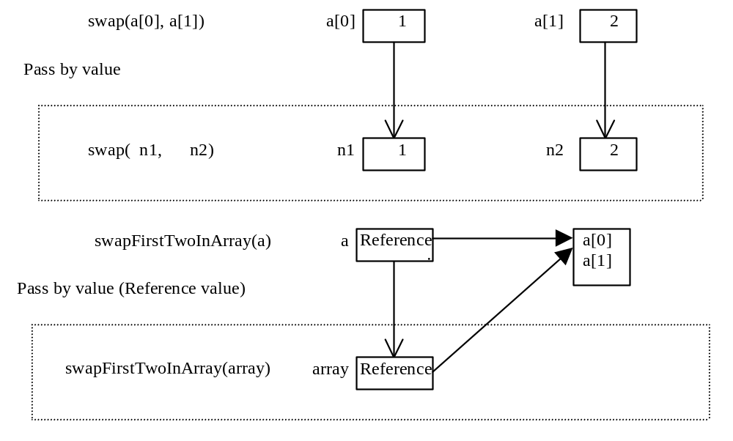
Example 5.3, cont.
17 october 2016
Akash Kumar Choudhary

Slide 15
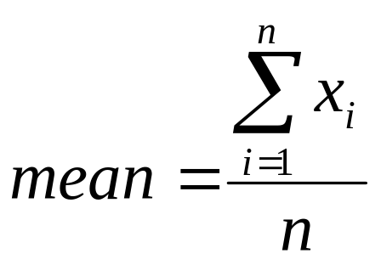
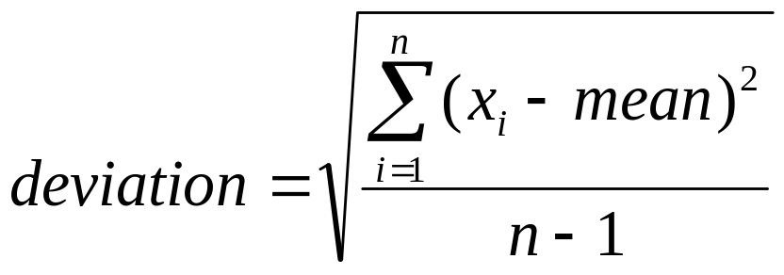
Example 5.4 Computing Deviation Using Arrays
Deviation
Run
17 october 2016
Akash Kumar Choudhary

Slide 16
Example 5.5
Counting Occurrence of Each Letter
Generate 100 lowercase letters randomly and assign to an array of characters.
Count the occurrence of each letter in the array.
Find the mean and standard deviation of the counts.
CountLettersInArray
Run
17 october 2016
Akash Kumar Choudhary

Slide 17
Example 5.6
Copying Arrays
In this example, you will see that a simple assignment cannot copy arrays in the following program. The program simply creates two arrays and attempts to copy one to the other, using an assignment statement.
TestCopyArray
Run
17 october 2016
Akash Kumar Choudhary

Slide 18
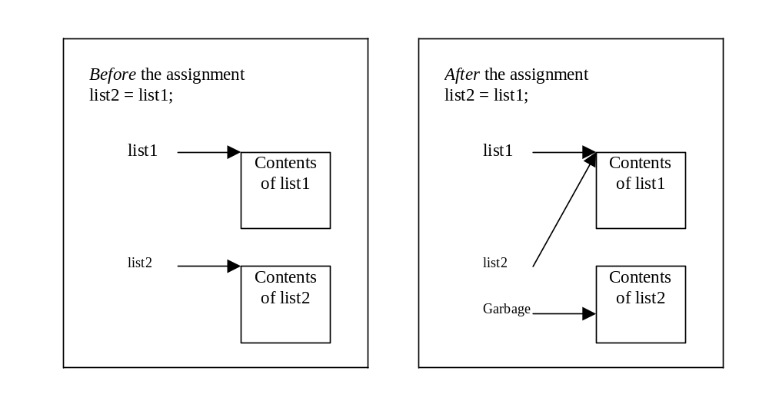
Copying Arrays
17 october 2016
Akash Kumar Choudhary

Slide 19
Copying Arrays
Using a loop:
int[] sourceArray = {2, 3, 1, 5, 10};
int[] targetArray = new int[sourceArray.length];
for (int i = 0; i < sourceArrays.length; i++)
targetArray[i] = sourceArray[i];
17 october 2016
Akash Kumar Choudhary

Slide 20
The arraycopy Utility
arraycopy(sourceArray, src_pos, targetArray, tar_pos, length);
Example:
System.arraycopy(sourceArray, 0, targetArray, 0, sourceArray.length);
17 october 2016
Akash Kumar Choudhary

Slide 21
Multidimensional Arrays
Declaring Variables of Multidimensional Arrays and Creating Multidimensional Arrays
int[][] matrix = new int[10][10];
or
int matrix[][] = new int[10][10];
matrix[0][0] = 3;
for (int i=0; i<matrix.length; i++)
for (int j=0; j<matrix[i].length; j++)
{
matrix[i][j] = (int)(Math.random()*1000);
}
double[][] x;
17 october 2016
Akash Kumar Choudhary

Slide 22
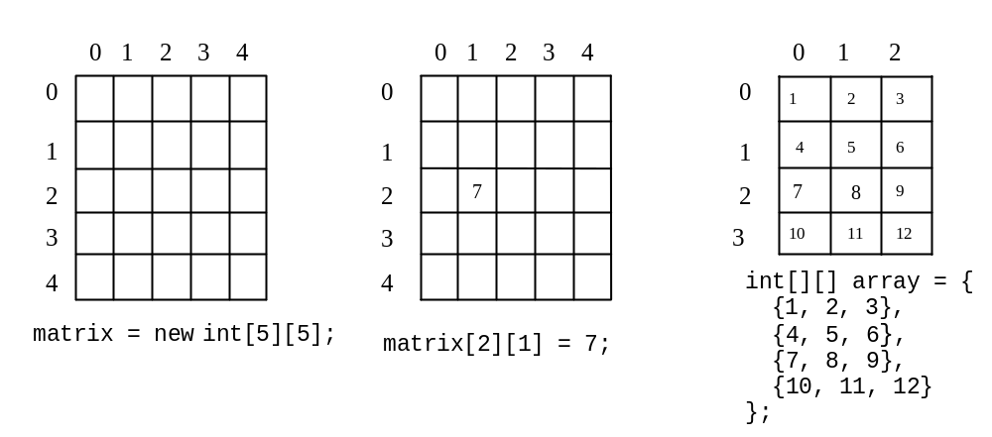
Multidimensional Array Illustration
17 october 2016
Akash Kumar Choudhary

Slide 23
Declaring, Creating, and Initializing Using Shorthand Notations
You can also use a shorthand notation to declare, create and initialize a two-dimensional array. For example,
int[][] array = {
{1, 2, 3},
{4, 5, 6},
{7, 8, 9},
{10, 11, 12}
};
This is equivalent to the following statements:
int[][] array = new int[4][3];
array[0][0] = 1; array[0][1] = 2; array[0][2] = 3;
array[1][0] = 4; array[1][1] = 5; array[1][2] = 6;
array[2][0] = 7; array[2][1] = 8; array[2][2] = 9;
array[3][0] = 10; array[3][1] = 11; array[3][2] = 12;
17 october 2016
Akash Kumar Choudhary

Slide 24
Lengths of Multidimensional Arrays
int[][] array = {
{1, 2, 3},
{4, 5, 6},
{7, 8, 9},
{10, 11, 12}
};
array.length
array[0].length
array[1].length
array[2].length
17 october 2016
Akash Kumar Choudhary

Slide 25
Ragged Arrays
Each row in a two-dimensional array is itself an array. So, the rows can have different lengths. Such an array is known as a ragged array. For example,
int[][] matrix = {
{1, 2, 3, 4, 5},
{2, 3, 4, 5},
{3, 4, 5},
{4, 5},
{5}
};
17 october 2016
Akash Kumar Choudhary

Slide 26
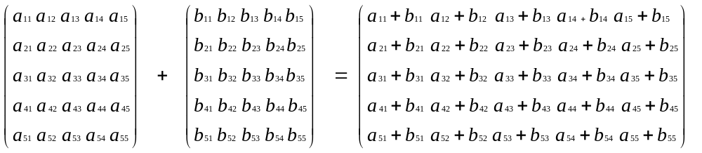
Example 5.7
Adding and Multiplying Two Matrices
Objective: Use two-dimensional arrays to create two matrices, and then add and multiply the two matrices.
TestMatrixOperation
Run
17 october 2016
Akash Kumar Choudhary

Slide 27
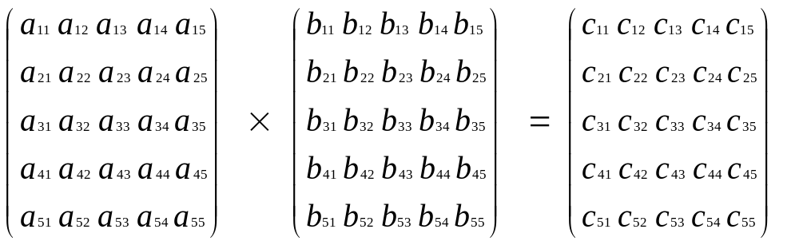
Example 5.7 (cont) Adding and Multiplying Two Matrices
c_{ij} = a_{i1}×b_{1j}+a_{i2}×b_{2j}+a_{i3}×b_{3j}+a_{i4}×b_{4j}+a_{i5}×b_{5j}
17 october 2016
Akash Kumar Choudhary

Slide 28
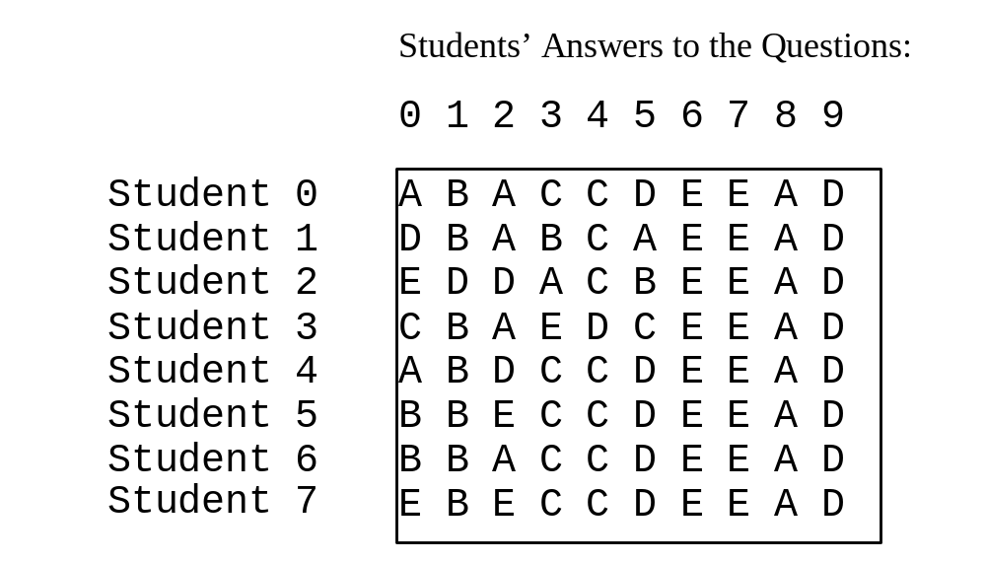
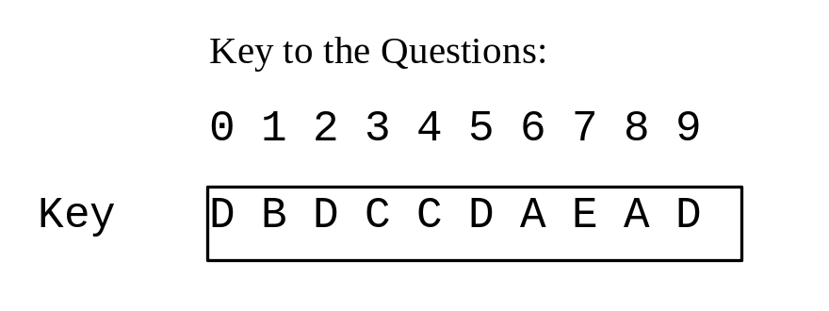
Example 5.8
Grading Multiple-Choice Test
Objective: write a program that grades multiple-choice test.
Grade Exam
Run
17 october 2016
Akash Kumar Choudhary

Slide 29
Example 5.9
Calculating Total Scores
Objective: write a program that calculates the total score for students in a class. Suppose the scores are stored in a three-dimensional array named scores. The first index in scores refers to a student, the second refers to an exam, and the third refers to the part of the exam. Suppose there are 7 students, 5 exams, and each exam has two parts--the multiple-choice part and the programming part. So, scores[i][j][0] represents the score on the multiple-choice part for the i’s student on the j’s exam. Your program displays the total score for each student, .
TotalScore
Run
17 october 2016
Akash Kumar Choudhary

Slide 30
Searching Arrays
Searching is the process of looking for a specific element in an array; for example, discovering whether a certain score is included in a list of scores. Searching, like sorting, is a common task in computer programming. There are many algorithms and data structures devoted to searching. In this section, two commonly used approaches are discussed, linear search and binary search.
17 october 2016
Akash Kumar Choudhary

Slide 31
Linear Search
The linear search approach compares the key element, key, with each element in the array list[]. The method continues to do so until the key matches an element in the list or the list is exhausted without a match being found. If a match is made, the linear search returns the index of the element in the array that matches the key. If no match is found, the search returns -1.
17 october 2016
Akash Kumar Choudhary

Slide 32
Example 5.10
Testing Linear Search
Objective: Implement and test the linear search method by creating an array of 10 elements of int type randomly and then display this array. Prompt the user to enter a key for testing the linear search.
LinearSearch
Run
17 october 2016
Akash Kumar Choudhary

Slide 33
Binary Search
For binary search to work, the elements in the array must already be ordered. Without loss of generality, assume that the array is in ascending order.
e.g. 2 4 7 10 11 45 50 59 60 66 69 70 79
The binary search first compares the key with the element in the middle of the array. Consider the following three cases:
17 october 2016
Akash Kumar Choudhary

Slide 34
Binary Search, cont.
• If the key is less than the middle element, you only need to search the key in the first half of the array.
• If the key is equal to the middle element, the search ends with a match.
• If the key is greater than the middle element, you only need to search the key in the second half of the array.
17 october 2016
Akash Kumar Choudhary

Slide 35
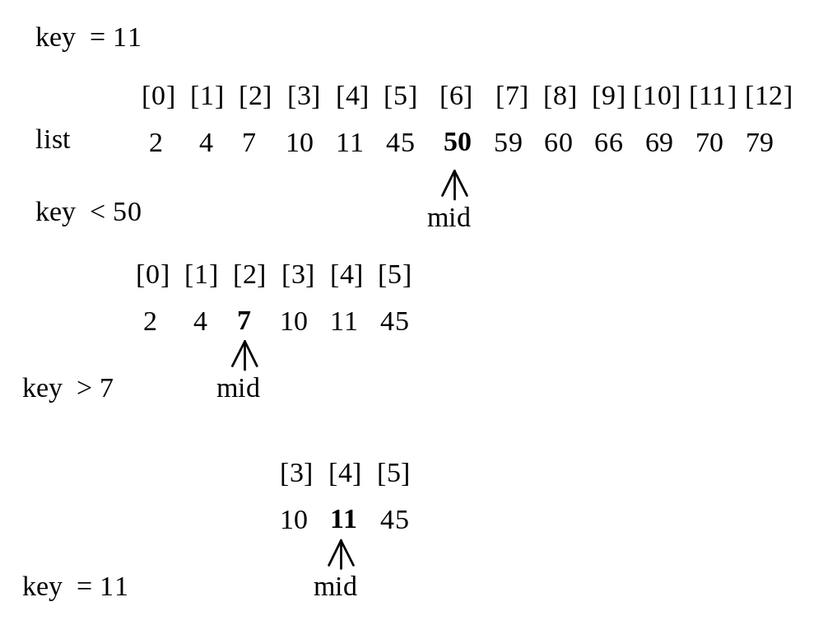
Binary Search, cont.
17 october 2016
Akash Kumar Choudhary

Slide 36
Example 5.11
Testing Binary Search
Objective: Implement and test the binary search method. The program first creates an array of 10 elements of int type. It displays this array and then prompts the user to enter a key for testing binary search.
BinarySearch
Run
17 october 2016
Akash Kumar Choudhary

Slide 37
Example 5.12
Using Arrays in Sorting
Objective: Use the selectionSort method to write a program that will sort a list of double floating-point numbers.
int[] myList = {2, 9, 5, 4, 8, 1, 6}; // Unsorted
Sort it to produce 1, 2, 4, 5, 6, 8, 9
2, 9, 5, 4, 8, 1, 6
SelectionSort
Run
17 october 2016
Akash Kumar Choudhary

Slide 38
Example 5.12: (Cont) Using Arrays in Sorting
int[] myList = {2, 9, 5, 4, 8, 1, 6}; // Unsorted
Find the largest element in myList and swap it with the last element in myList.
2, 9, 5, 4, 8, 1, 6 => 2, 6, 5, 4, 8, 1, 9 (size = 7)
2, 6, 5, 4, 8, 1 => 2, 6, 5, 4, 1, 8 (size = 6)
2, 6, 5, 4, 1 => 2, 1, 5, 4, 6 (size = 5)
2, 1, 5, 4 => 2, 1, 4, 5
2, 1, 4 => 2, 1, 4,
2, 1 => 1, 2
Sort it to produce 1, 2, 4, 5, 6, 8, 9
17 october 2016
Akash Kumar Choudhary

Slide 39
Exercise 5.5: Bubble Sort
int[] myList = {2, 9, 5, 4, 8, 1, 6}; // Unsorted
Pass 1: 2, 5, 4, 8, 1, 6, 9
Pass 2: 2, 4, 5, 1, 6, 8, 9
Pass 3: 2, 4, 1, 5, 6, 8, 9
Pass 4: 2, 1, 4, 5, 6, 8, 9
Pass 5: 1, 2, 4, 5, 6, 8, 9
Pass 6: 1, 2, 4, 5, 6, 8, 9
17 october 2016
Akash Kumar Choudhary

